Slide 1

Underwriting Assistant
GenAI-Powered Risk Assessment Co-Pilot
Leveraging artificial intelligence to enhance insurance underwriting efficiency, accuracy, and decision-making capabilities in the digital age.
Presented By : ARUSHI SHIVHARE 22070521062
ANMOL CHOURASIA 22070521091
Notes:
1

Slide 2
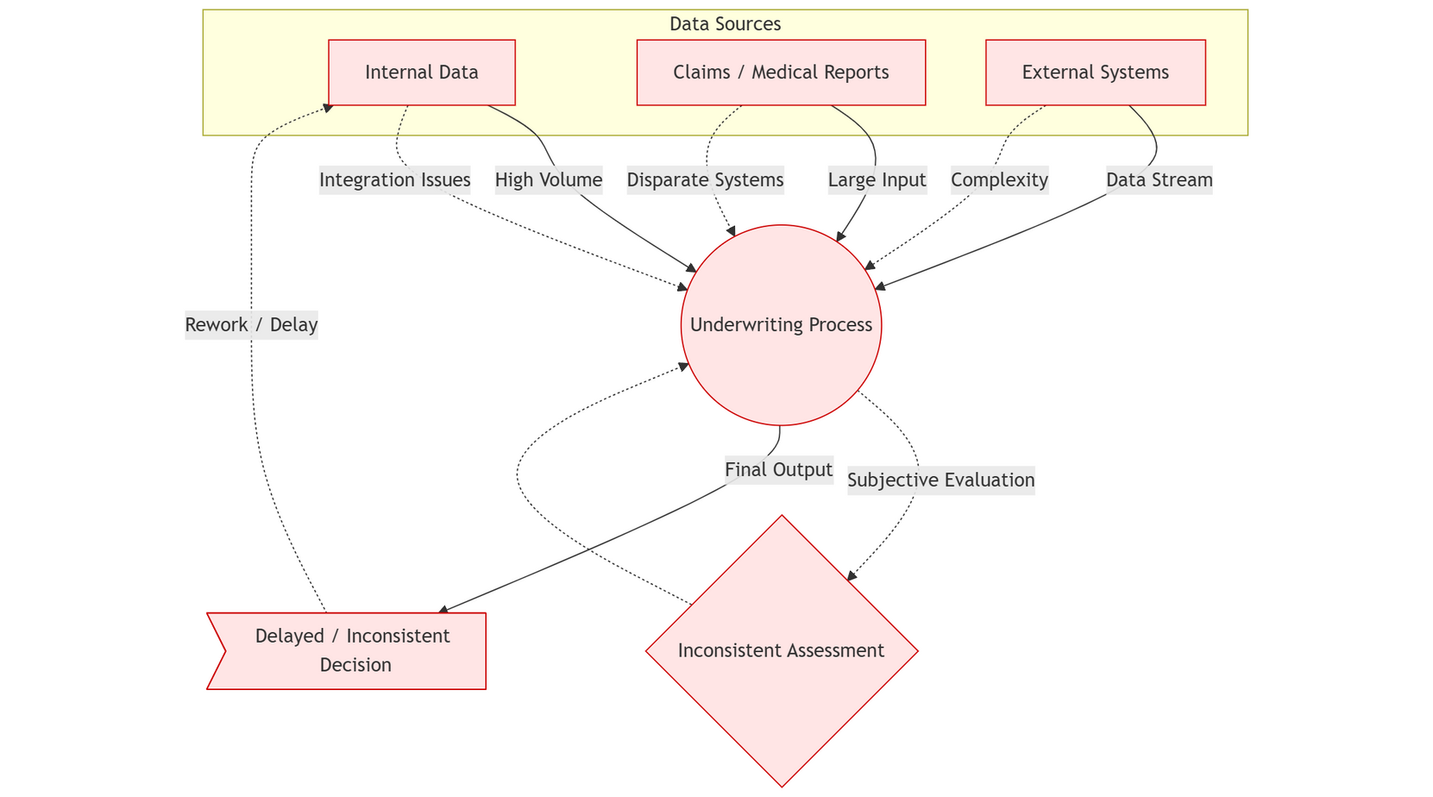
The Current Underwriting Landscape
Insurance underwriting is the critical process of evaluating applicant risk to determine eligibility, appropriate coverage levels, and accurate pricing. However, traditional underwriting methods face significant operational challenges in today's data-rich environment.
Volume Overload
Underwriters must process enormous volumes of structured and unstructured data from multiple sources, leading to bottlenecks and delayed decisions.
Inconsistent Assessment
Manual evaluation processes often result in subjective risk assessments that vary between underwriters, creating potential compliance issues.
Integration Complexity
Synthesizing information from disparate sources—claims history, medical reports, credit data, and external databases—remains time-intensive and error-prone.
Notes:
2

Slide 3



The Underwriting Challenge
Current Pain Points
Raw Data Inputs
Manual data analysis consuming 60-70% of underwriting time
Applications, claims, reports
Decision delays impacting customer experience and conversion rates
Manual Analysis
Time-intensive review
Subjective risk assessments leading to inconsistent outcomes
Risk Assessment
Limited capacity to handle growing application volumes
Subjective decisions
The industry needs an intelligent assistant that can summarize complex data and provide actionable, evidence-based insights.
Notes:
3

Slide 4
Bridging the Technology Gap
Existing underwriting tools rely on static dashboards and rigid rule-based systems that cannot adapt to complex scenarios or integrate diverse datasets for contextual insights.
Existing Tools
GenAI Assistant
Static dashboards with limited interactivity
Automated intelligent summarisation
Rule-based systems lacking flexibility
Multi-source data integration
Single-source data analysis
Contextual risk analysis
No contextual recommendations
Actionable recommendations
The Research Gap: A GenAI-powered co-pilot that analyses, synthesises, and outputs actionable recommendations by processing diverse datasets in context.
Notes:
4

Slide 5
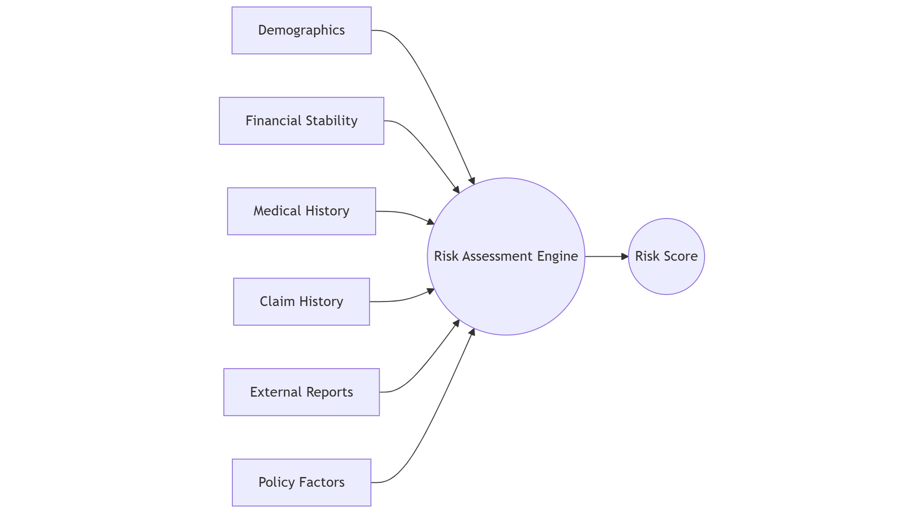
Our Solution: Intelligent Risk Assessment
Risk Score Parameters
Applicant Demographics
Age, gender, occupation
Financial Stability
Income, credit score, existing loans
Health & Medical History
Chronic conditions, prior medical claims
Prior Claim History
Frequency, severity, claim amounts
External Reports
Legal issues, fraud alerts, background checks
Policy-Specific Factors
Coverage type, insured amount, term
The Underwriting Assistant leverages generative AI to summarise applicant data, analyse prior claims, and integrate external reports to generate comprehensive risk scores.
Each parameter receives a weighted score, contributing to an overall risk classification:
Low Risk, Medium Risk, or High Risk.
Notes:
5

Slide 6
Weighted Risk Scoring Framework
Our scoring approach assigns specific weightages to each parameter based on actuarial significance and historical data analysis. This ensures consistent, objective risk evaluation across all applicants.
Parameter
Weightage
Sample Score
Impact Notes
Age & Demographics
10%
7/10
Younger applicants typically present lower risk profiles
Credit Score
20%
8/10
Higher credit scores correlate with lower risk behaviour
Prior Claims History
30%
6/10
Frequent or high-value claims significantly increase risk
Health History
20%
5/10
Chronic illnesses and pre-existing conditions elevate risk
External Reports
20%
9/10
Legal issues, fraud alerts, or adverse reports increase risk
Notes:
6

Slide 7
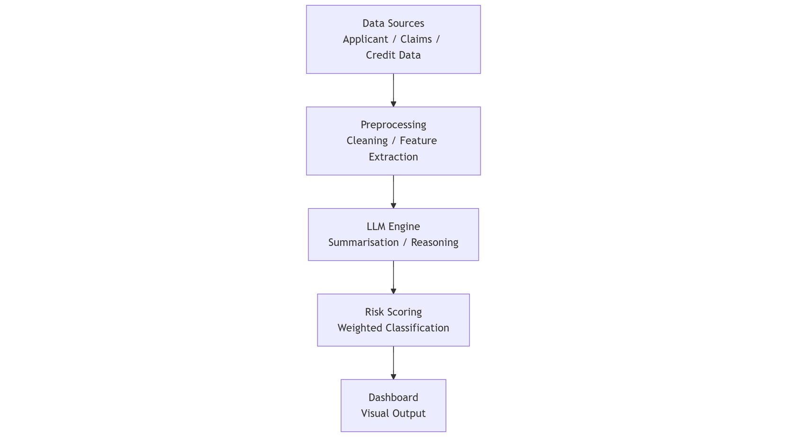



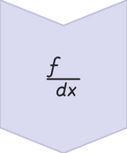

Solution Architecture
The Underwriting Assistant employs a sophisticated multi-stage processing pipeline that integrates data ingestion, AI-powered analysis, and intelligent visualisation.
Data Sources
Applicant information, prior claims, external reports, credit data
Preprocessing
Data cleaning, normalisation, feature extraction, validation
LLM Engine
Prompt chaining, summarisation, contextual reasoning
Risk Scoring
Weighted parameter scoring and classification
Output Dashboard
Visualisations, summaries, recommendations
Notes:
7

Slide 8




Technical Implementation Stack
Data Processing
Machine Learning & AI
Python with Pandas and NumPy for efficient data manipulation, SQL for database queries and structured data retrieval across multiple sources.
Scikit-learn for predictive modelling, advanced LLM prompt chaining for intelligent summarisation and contextual analysis of complex datasets.
Visualisation & Reporting
Cloud Infrastructure
Matplotlib and Seaborn for statistical visualisations, Power BI or Dash for interactive dashboards providing real-time insights.
AWS or Azure platforms for scalable processing, secure data storage, and enterprise-grade deployment with high availability.
Notes:
8

Slide 9
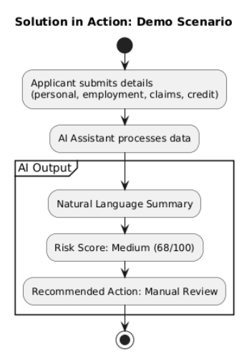
Solution in Action: Demo Scenario
Sample Case Study
AI Assistant Output
An applicant submits comprehensive information including personal details, employment history, prior insurance claims, and credit reports.
1
2
Natural Language Summary
Risk Score Classification
"Applicant presents moderate risk profile with stable employment but elevated prior claims history requiring review."
Medium Risk (68/100) with detailed parameter breakdown and contributing factors.
3
Recommended Action
Manual review recommended with suggested premium adjustment of 15-20% above standard rates.
Notes:
9

Slide 10
Transformative Benefits & Future Roadmap
60%
85%
3x
100%
Time Reduction
Consistency Rate
Volume Capacity
Transparency
Faster underwriting decisions through automated analysis
Objective, repeatable risk assessments
Efficient handling of application volumes
Explainable scoring methodology
Future Enhancements:
Current State
Long-Term Vision
GenAI-powered risk assessment and summarisation
Personalised recommendations with continuous learning from emerging data patterns
1
2
3
Short-Term
Real-time fraud detection integration and advanced analytics
The Underwriting Assistant bridges the critical gap between data overload and actionable insights, empowering underwriters to make faster, more accurate decisions while maintaining transparency and regulatory compliance.
Notes:
10

Slide 11
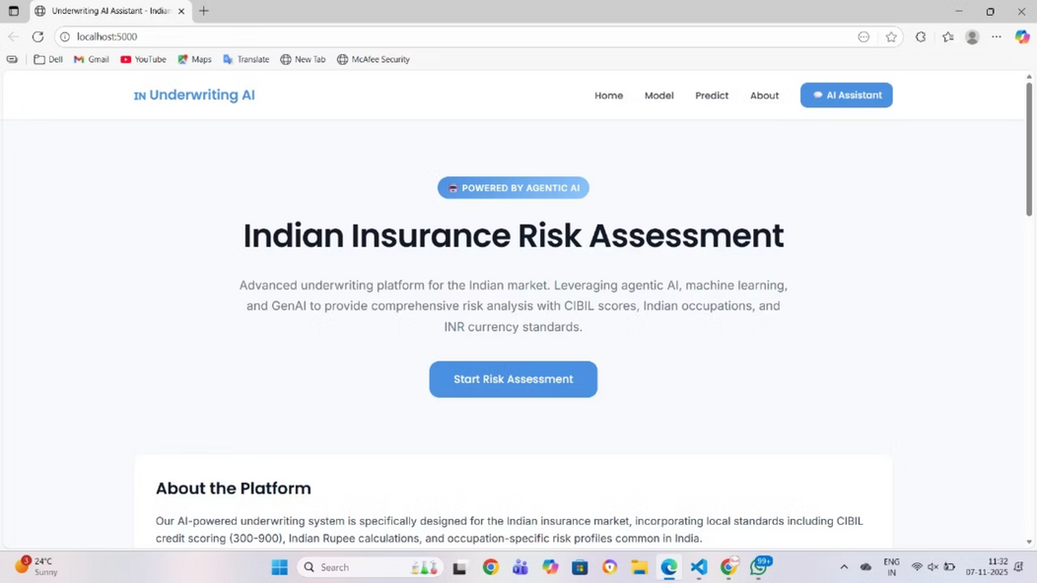
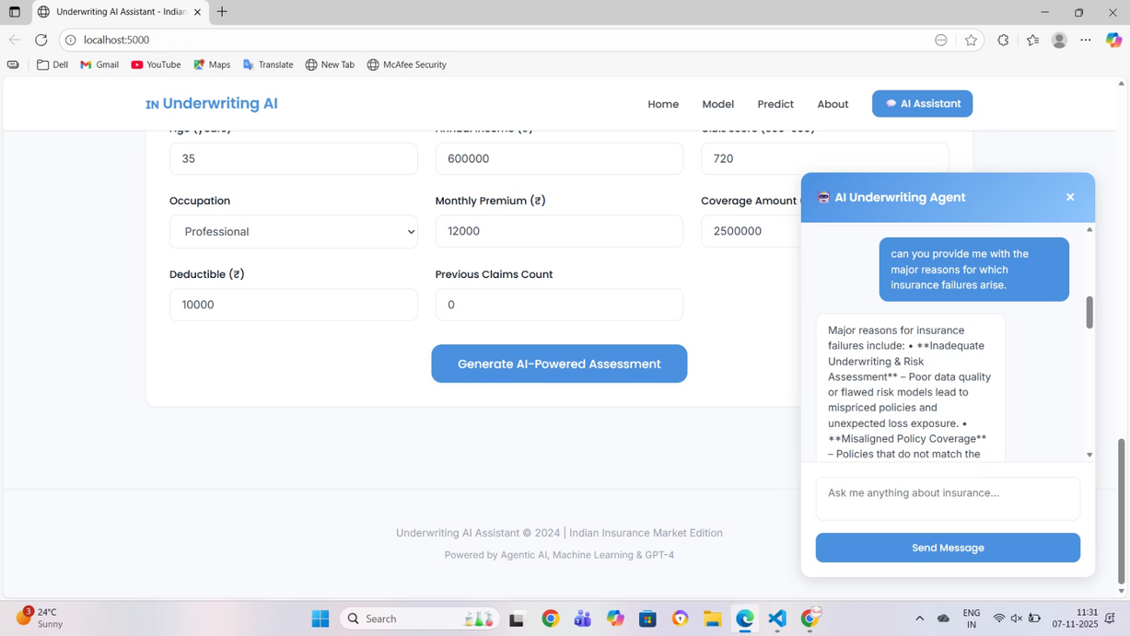
Deployed App Details
Premium Underwriting AI Assistant is a web-based underwriting decision support system that evaluates insurance applicants using a hybrid approach of Machine Learning + GenAI + Agentic AI. The app accepts applicant details (age, income, occupation, premium, prior claims, CIBIL score, etc.) and:
Calculates a comprehensive risk score
Predicts Low / Medium / High risk using a trained ML model
Generates policy recommendations
Determines the required documents
Allows interactive conversation through a built-in AI underwriting chatbot
The system is specifically designed for the Indian insurance market, incorporating Indian income ranges, premium affordability, CIBIL scoring, and occupation-based risk categorization.
The app improves underwriting efficiency by automating risk assessment, reducing manual evaluation time, and providing explainable AI insights.
Notes:
11

Slide 12
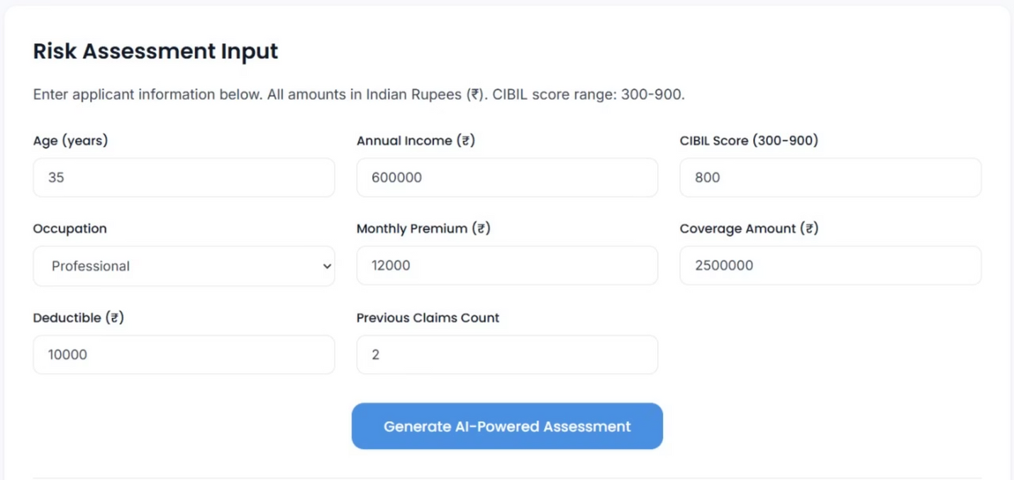
Risk Assessment — Feature Overview
The Risk Assessment Engine thoroughly evaluates an insurance applicant's profile to compute a comprehensive risk score. This system meticulously analyzes multiple underwriting factors, assigning weighted impact percentages to accurately determine if an applicant falls into a Low, Medium, or High Risk category.
1
2
3
4
CIBIL / Credit Score (35%)
Previous Claims History (30%)
Premium Affordability (20%)
Age of Applicant (10%)
Higher scores reduce risk; a score below 600 typically triggers a high-risk classification, indicating significant financial impact.
A greater number of past claims directly increases the risk score and signals a higher probability of future claims, reflecting behavioral patterns.
This assesses the financial burden the proposed premium places on the applicant's annual income, ensuring sustainable financial stability.
Applicants aged 30–50 years are typically considered the lowest risk; those outside this optimal range generally see an increase in their risk score.
5
Occupation Risk Category (5%)
Individuals in high-risk professions, such as construction workers or drivers, contribute to an elevated overall risk due to inherent occupational hazards.
Notes:
12

Slide 13
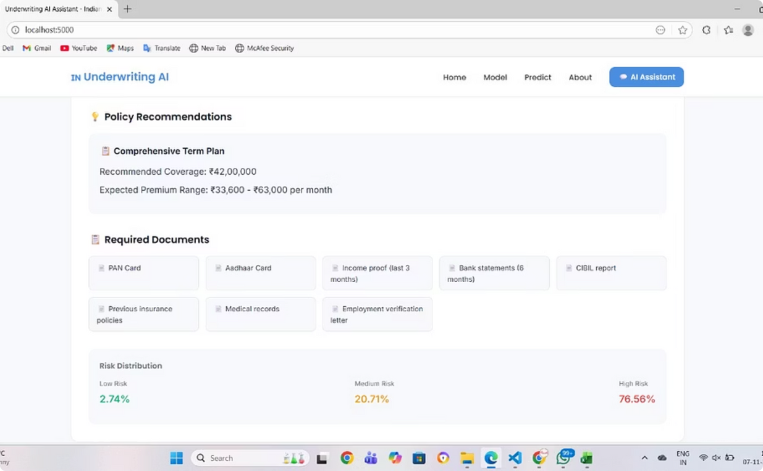
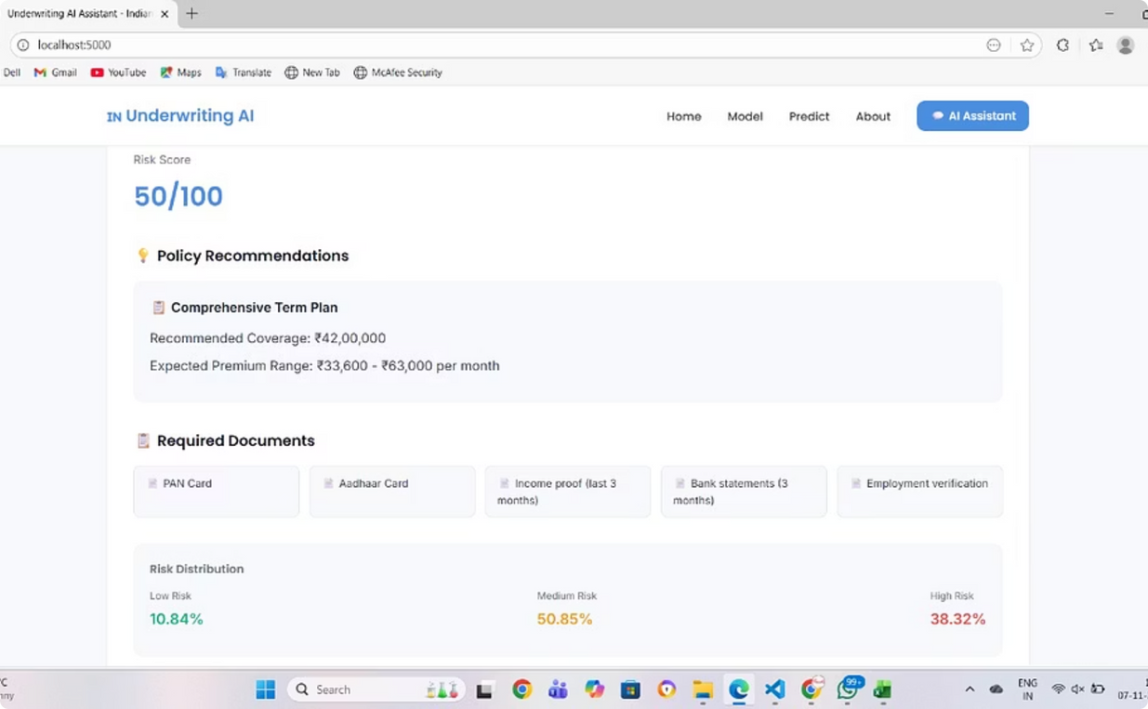
Risk Assessment – Scenario Evaluation
Scenario 1: High Risk Applicant
Scenario 2: Medium Risk Applicant
Applicant Profile: Age: 57, Annual Income: ₹3.2 Lakhs, CIBIL Score: 580, Previous Claims: 3, Monthly Premium: ₹18,000, Occupation: Construction Worker.
Applicant Profile: Age: 32, Annual Income: ₹9 Lakhs, CIBIL Score: 690, Previous Claims: 1, Monthly Premium: ₹9,500, Occupation: Sales Executive.
Risk Assessment Output: 🔴 High Risk
Risk Assessment Output: 🟡 Medium Risk
Low CIBIL score (35% weight)
Fair CIBIL score (35% weight)
Multiple past claims (30% weight)
Limited claims history (1 claim) (30% weight)
Premium burden > 8% of annual income (20% weight)
Premium affordability within reasonable limit (20% weight)
Age outside optimal range (10% weight)
Age within acceptable underwriting range (10% weight)
High-risk occupation (5% weight)
Medium-risk occupation (5% weight)
Decision Insight: Applicant may default or generate future claims. Additional documentation & underwriting checks required.
Decision Insight: Eligible with standard checks. Policy can be approved with normal documentation.
Notes:
13

Slide 14

Thank You!
We appreciate your time and attention today.
Any questions?
Notes:
14

